Slide 1
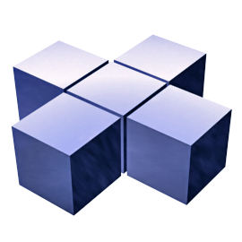
WinRT Components Universal Windows Platform
Dale Stammen
Senior Program Managineer
dalestam@microsoft.com

Slide 2
WinRT Components
A Windows Runtime component is a DLL that's callable from a Windows 10 UWP app that's built by using JavaScript—or C#, Visual Basic, or C++.

Slide 3
WinRT Components
There are several reasons for building such a component:
To get the performance advantage of C++ in complex or computationally intensive operations.
To reuse code that's already written and tested.

Slide 4
WinRT Components
In general, when you code your C++ component, use the regular C++ library and built-in types, except at the abstract binary interface (ABI) boundary where you are passing data to and from code in another .winmd package. There, use Windows Runtime types and the special syntax that Visual C++ supports for creating and manipulating those types. In addition, in your Visual C++ code, use types such as delegate and event to implement events that can be fired from your component and handled in JavaScript, Visual Basic, or C#. For more information about the new Visual C++ syntax, see Visual C++ Language Reference (C++/CX).

Slide 5
WinRT Components
Only Windows Runtime types can be passed across the ABI boundary. The compiler will raise an error if the component has a type like std::wstring as a return type or parameter in a public method.
The Visual C++ component extensions (C++/CX) built-in types include the usual scalars such as int and double, and also their typedef equivalents int32,float64, and so on.For more information, see Type System (C++/CX).

Slide 6
Demo
SimpleWinRTComponentExample

Slide 7
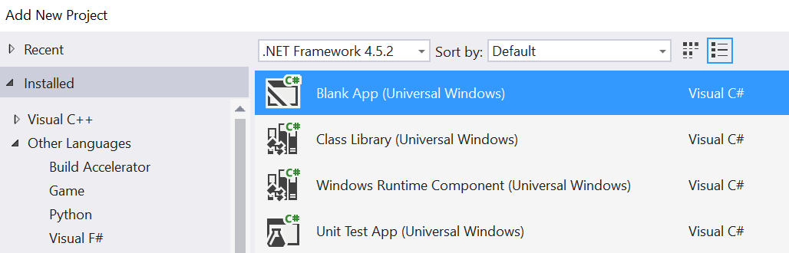
C# Demo
Add a new C# Project project

Slide 8
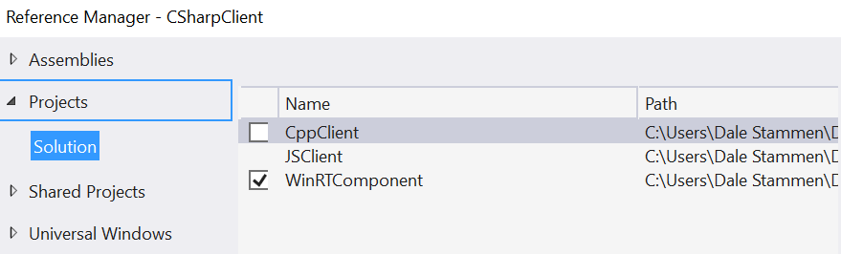
C# Client Demo
Add a reference to the WinRTComponent Project

Slide 9
C# Client Demo
Replace <Grid> in MainPage.xaml with:
<StackPanel x:Name="contentPanel" Margin="120,30,0,0">
<TextBlock HorizontalAlignment="Left" Text="WinRT Component" FontSize="36"/>
<StackPanel x:Name="inputPanel" Orientation="Horizontal" Margin="0,20,0,20">
<Button x:Name="inputButton" Content="Get String" Click="Button_Click"/>
</StackPanel>
<TextBlock x:Name="resultsText"/>
</StackPanel>

Slide 10
C# Client Demo
Add Button_Click handler to MainPage.cs:
private void Button_Click(object sender, RoutedEventArgs e)
{
var component = new WinRTComponent.Class1();
resultsText.Text = component.GetString();
}

Slide 11
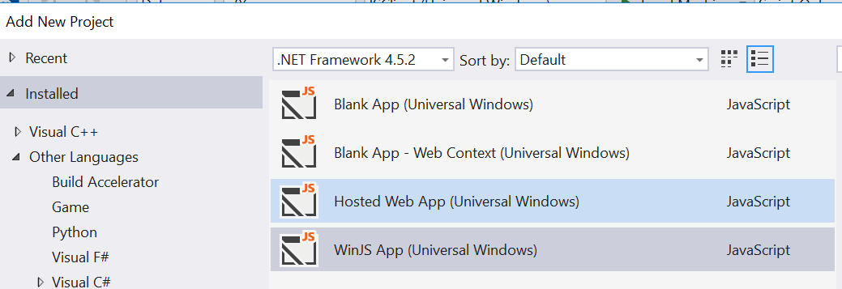
JSClient Demo
Add a new WinJS project

Slide 12
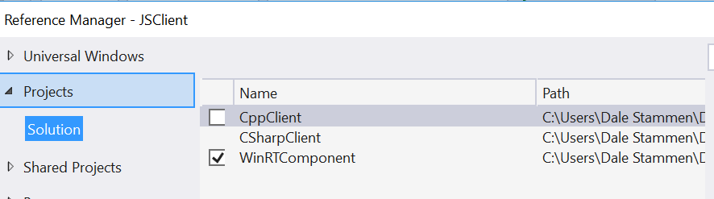
JSClient Demo
Add a reference to the WinRTComponent Project

Slide 13
JSClient Demo
Replace <body/> in index.html with
<body class="win-type-body">
<button id="button1">Get String</button>
<p id="button1Output"></p>
</body>

Slide 14
JSClient Demo
Add to end of main.js
// The click event handler for button1
function button1Click(mouseEvent) {
var component = new WinRTComponent.Class1();
var button1Output = document.getElementById("button1Output");
button1Output.innerText = component.getString();
}

Slide 15
JSClient Demo
In main.js replace args.setPromise(WinJS.UI.processAll()) with
args.setPromise(WinJS.UI.processAll().done(function () {
var button1 = document.getElementById("button1");
button1.addEventListener("click", button1Click, false);
}));

Slide 16
Code Samples
https://github.com/stammen/uwp-cpp-examples
SimpleWinRTComponentExample
WinRTComponentExample

Slide 17
WinRT Component References
Walkthrough: Creating a basic Windows Runtime component in C++ and calling it from JavaScript or C#
Creating Windows Runtime Components in C++
Walkthrough: Creating a Windows Runtime component in C++ and calling it from JavaScript or C#

